Slide 1

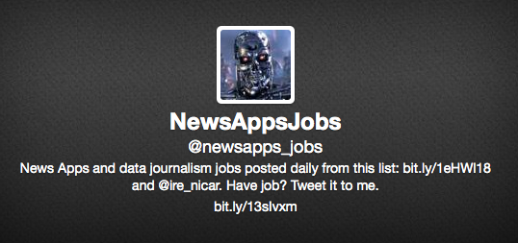
@newsapps_jobs: a meditation on twitter bots
http://omahajoe.org/blog/2014/02/25/at-newsapps-jobs-a-meditation-on-twitter-bots/
joe kokenge @josephkokenge @newsapps_jobs

Slide 2

what is a twitter bot?
class Twitterbot
attr_accessor :jobs, :twitter_config, :gdrive_session, :job_worksheet
def initialize
@twitter_config = Psych.load_file('config/config.yml')
Twitter.configure do |config|
config.consumer_key = @twitter_config['consumer_key']
config.consumer_secret = @twitter_config['consumer_secret']
config.oauth_token = @twitter_config['oauth_token']
config.oauth_token_secret = @twitter_config['oauth_token_secret']
end
end
end

Slide 3
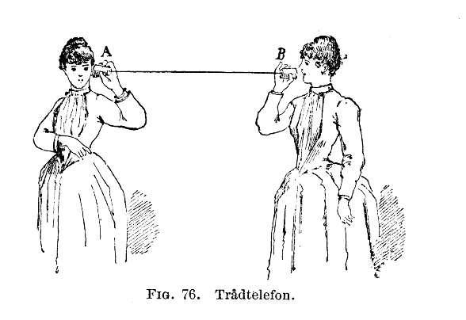
what is the twitter api?

Slide 4
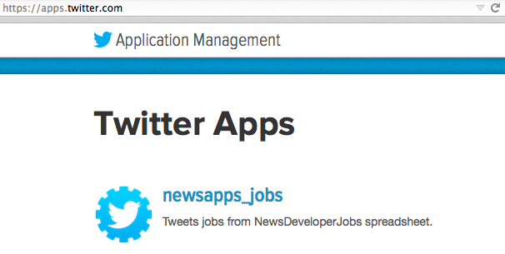
first step...apps.twitter.com
consumer_key, consumer_secret, oauth_token, oauth_token_secret
“rJm0KewaH87Kmit3LQXX5r”

Slide 5
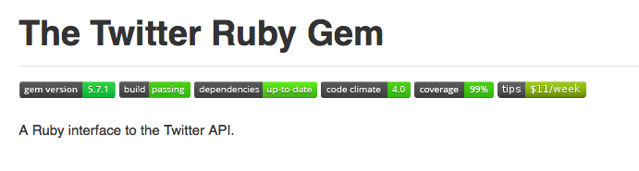
it’s all about libraries!
https://dev.twitter.com/docs/twitter-libraries

Slide 6
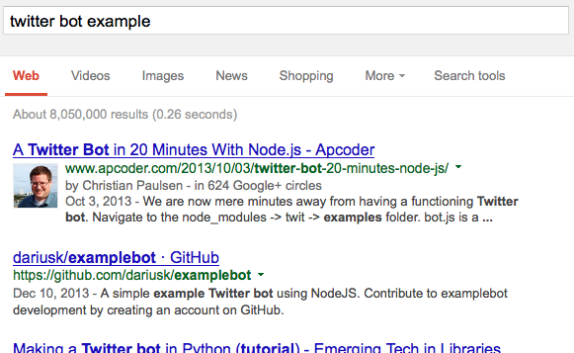
find an example!
http://neotricprogramming.blogspot.com/2013/01/the-python-tutorial-for-twitter-bots.html

Slide 7
start small…“Hello World!”
client = Twitter::REST::Client.new do |config| config.consumer_key = "YOUR_CONSUMER_KEY" config.consumer_secret = "YOUR_CONSUMER_SECRET" config.access_token = "YOUR_ACCESS_TOKEN" config.access_token_secret = "YOUR_ACCESS_SECRET"
end
client.update("I'm tweeting!!!!!")
From documentation for Twitter Gem

Slide 8

build from humble beginnings….
https://github.com/jkokenge/bots/blob/master/newsappsjobs.rb

Slide 9
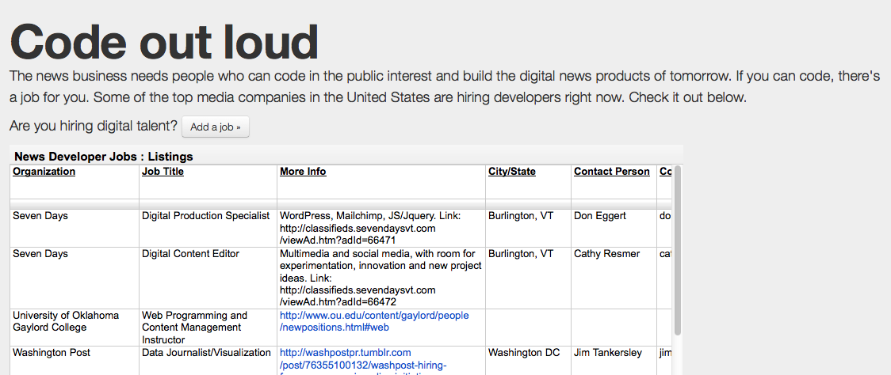
why a bot?

Slide 10
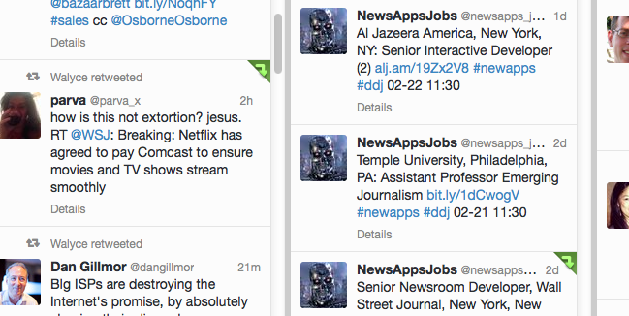
easy...scrollin!

Slide 11

success?
170 followers, 252 tweets, 16 folks shared jobs spreadsheet!
But, did anyone actually get a job….

Slide 12

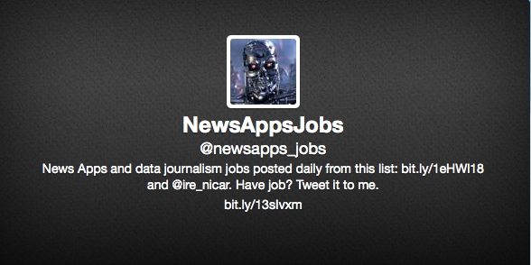
but, this looks familiar….

